Slide 1
Gravitational Wave Signal From Binary Star Systems
December 20, 2022
Liam Keeley
https://github.com/3-3-3/Gravitational_Waves

Slide 2
Topics
Background on gravitational waves
The Wahlquist equations and Keppler’s equation
Initial results
Peter’s equations and time evolution
Numerical routines and Comparison with analytical solution
Results

Slide 3
Gravitational Wave Background

Slide 4
Review of special relativity
Distance between points in 3D-space is not the same for all observers
Moving observers observe contracted distances
Moving observers experience less time after traveling some distance
In a relative world, time and space are not the same quantities for all observers. However, the following quantity is invariant in all inertial frames:
And is how we measure distance in flat spacetime

Slide 5
General Relativity
Similar to how distances on the surface of the Earth are warped because we must travel on the surface of a sphere, distances in space time are disturbed in the vicinity of high mass densities
When a large, asymmetric mass density moves at high velocities, these disturbances can propagate through space, and warp how distance is measured far from the original source

Slide 6
Gravitational Waves
These propagating disturbances are known as gravitational waves, and squeeze and stretch the distances between objects as the move through spacetime
Their effects can be decomposed into two polarizations, h-plus and h-cross, which act at 45° to each other

Slide 7

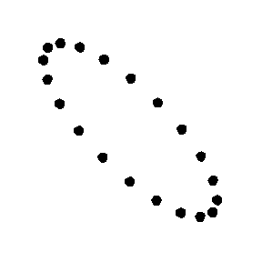
Physical Effect of Gravitational Waves
h+
hx

Slide 8
The Wahlquist Equations

Slide 9
Binary Star Systems
Binary star systems are solar systems with two stars in orbit about their mutual centers of mass
Such systems meet the criteria to produce gravitational waves:
Massive, moving, assymetric
When observing a binary system we need to consider the following parameters:
Orbital eccentricity, mass of each star
Orbital period or semimajor axis
Orientation and position of system relative to Earth

Slide 10
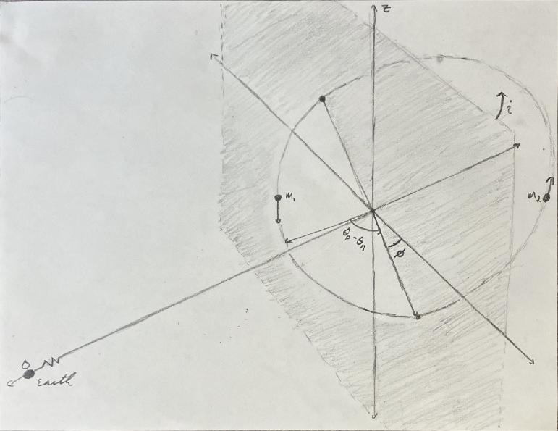
Orbit Orientation

Slide 11
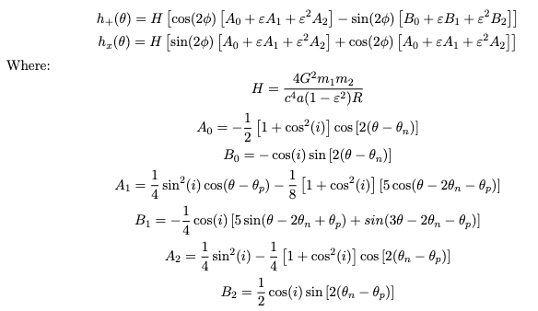
Wahlquist Equations
Notes:
Theta dependence vs. Time Dependence!

Slide 12
Kepler’s Equation

Slide 13
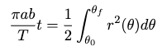
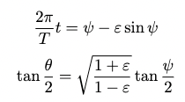
Relating Orbital Angle and Time
Most obvious solution is to use Kepler’s Second Law directly giving:
Difficult to invert to give orbital angle as a function of time
Better to change variables to parameter psi giving the following system of equations:
As first derivative of psi is easy to find, I chose to approximate psi with Newtons Method

Slide 14
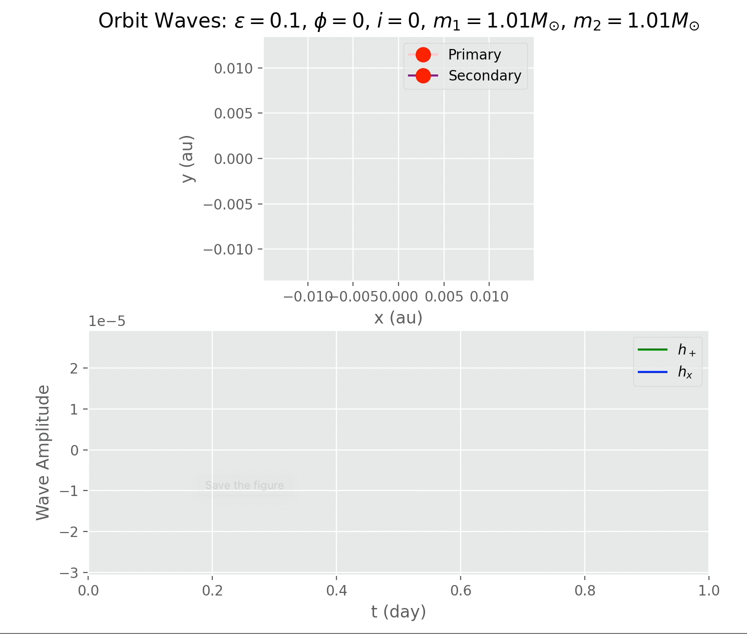
Results

Slide 15
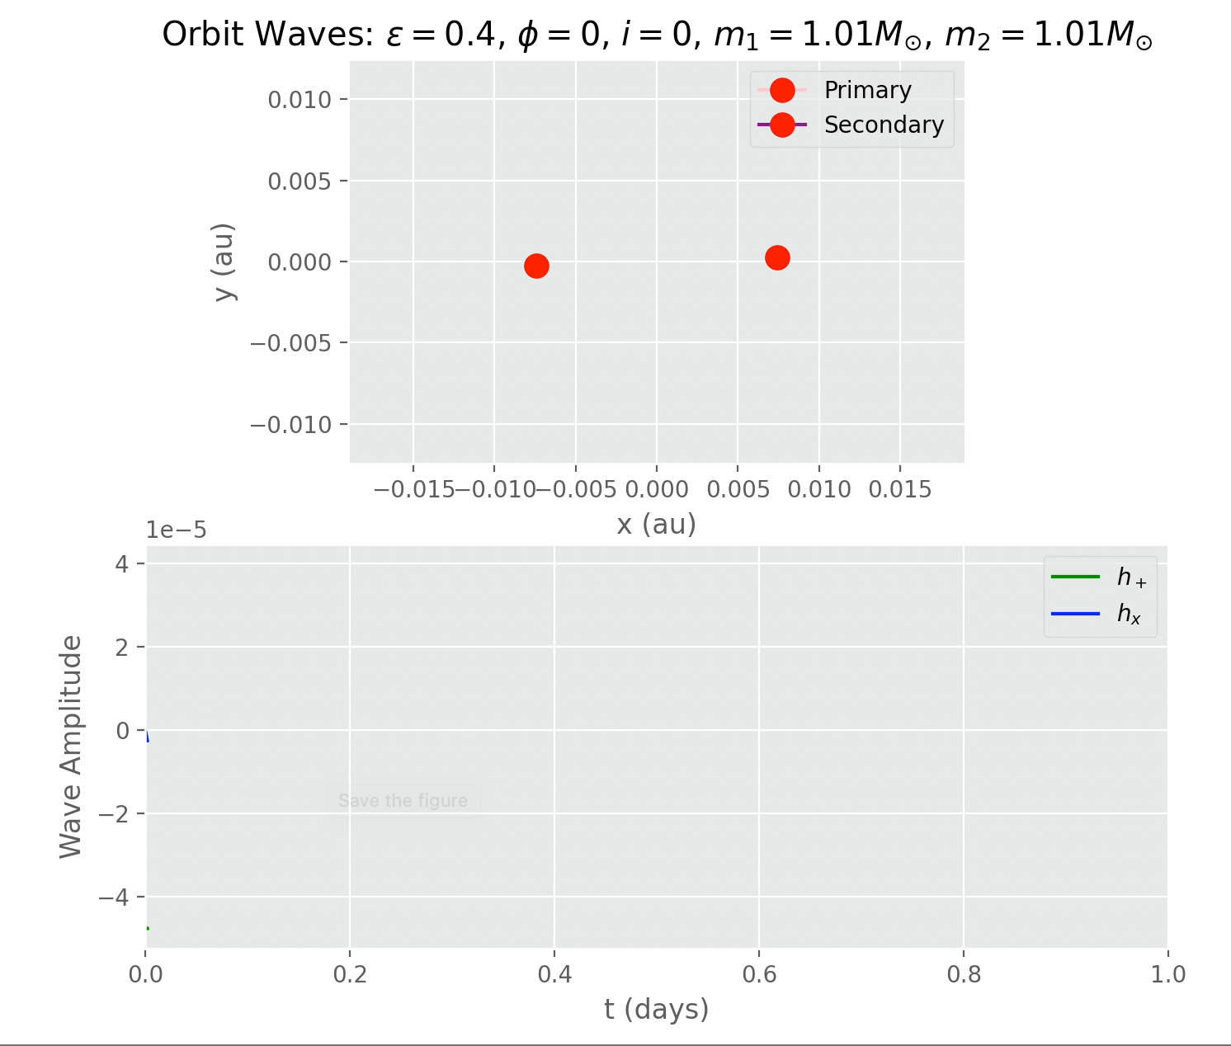
Results

Slide 16
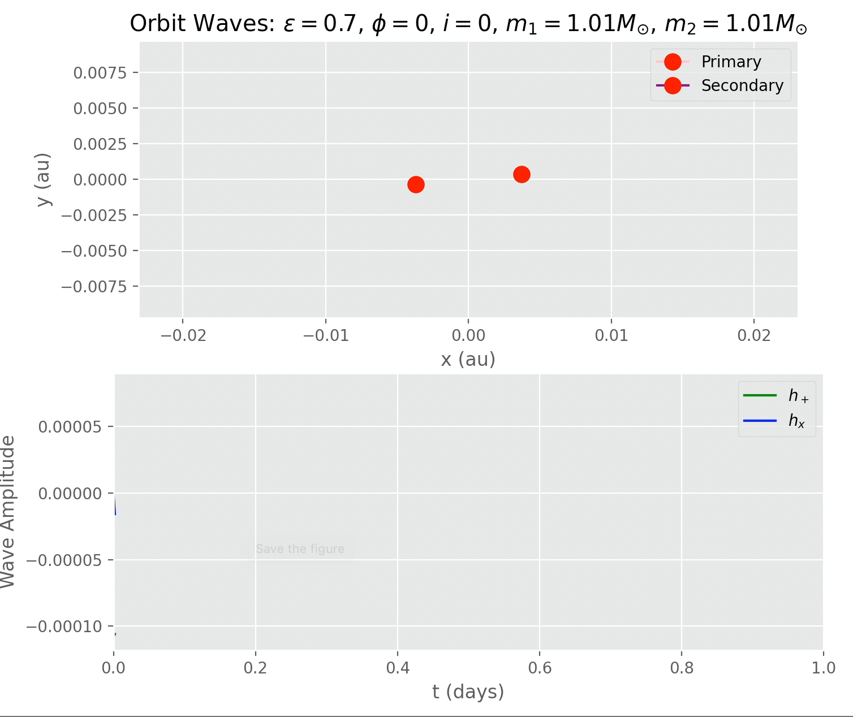
Results

Slide 17
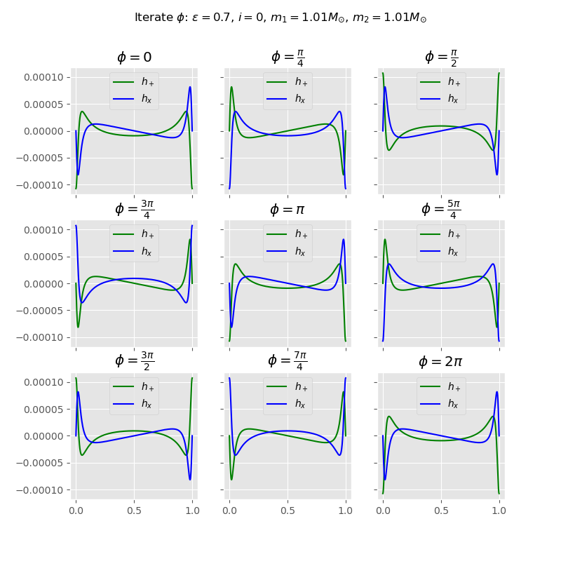
Results: Changing node orientation

Slide 18
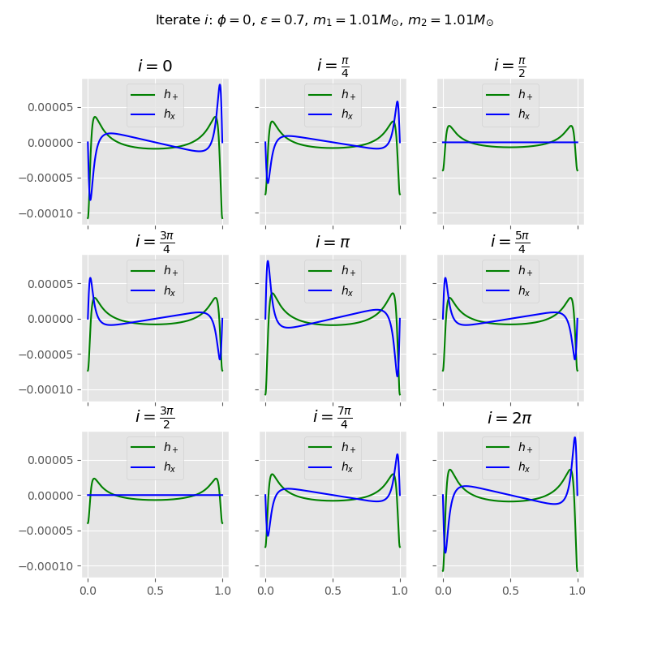
Results: Changing Inclination

Slide 19
Peter’s Equations and Time Evolution

Slide 20
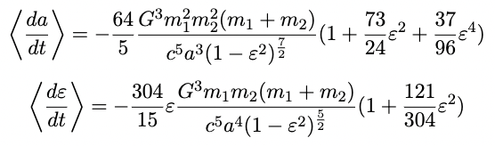
Decreasing Eccentricity, Semi-major Axis
Gravitational waves carry energy, so binary star system orbits must shed energy as they emit gravitational waves
From considerations of conservation of energy and angular momentum, Peters proposed the following equations for the time evolution of binary star system:

Slide 21
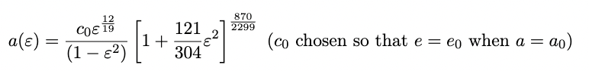
Decoupling
Can be decoupled by dividing and integrating, giving:
Only need to solve for eccentricity
Still quite difficult because change is gradual

Slide 22
Numerical Routines

Slide 23
Euler’s Method
Linear approximation
(Not surprisingly) not convergent

Slide 24
Runge-Kutta Methods
Improvement on Euler’s method
uses information from an initial Euler step to compute derivatives at a variety of points in the step interval
takes a weighted average of these points to estimate total change in function over the step interval

Slide 25
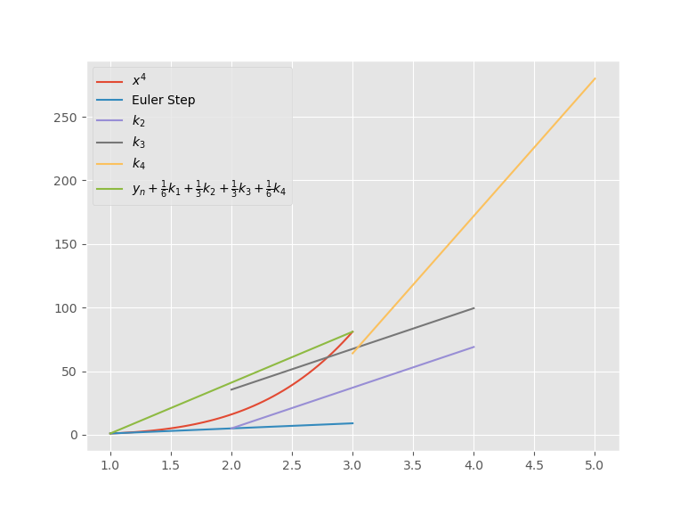
Fourth Order Runge-Kutta

Slide 26
Adaptive Step Size For Runge-Kutta Methods
Wish to take large steps where functions changes slowly, and small steps where it changes rapidly
Higher order Runge-Kutta methods have embedded formulas; we can combine each estimate k in multiple ways to arrive at an answer
Different combinations have error proportional to different powers of the step size; the difference estimates the error on the lower order method
Error estimation can be used to approximate error on lower order solution, and this can be used to update step size so both desired error and step sizes are achieved

Slide 27
Results and Other Methods
My own adaptive step size code took too many steps to estimate error to be efficient
Used a variety of routines provided in scipy.integrate (including the one I programmed)
Also failed, with step size getting too small

Slide 28
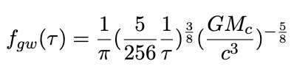
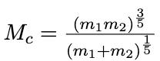
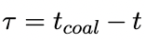
Check of Fourth Order Runge-Kutta Method
To highest order, our eccentricity derivative is proportional to the inverse square of the eccentricity
We expect eccentricity to be changing fastest in the circular orbit limit (directly before coalescence)
For circular orbit, there is the following analytic solution for thetime evolution of the gravitational wave frequency:
Where:
[6]

Slide 29
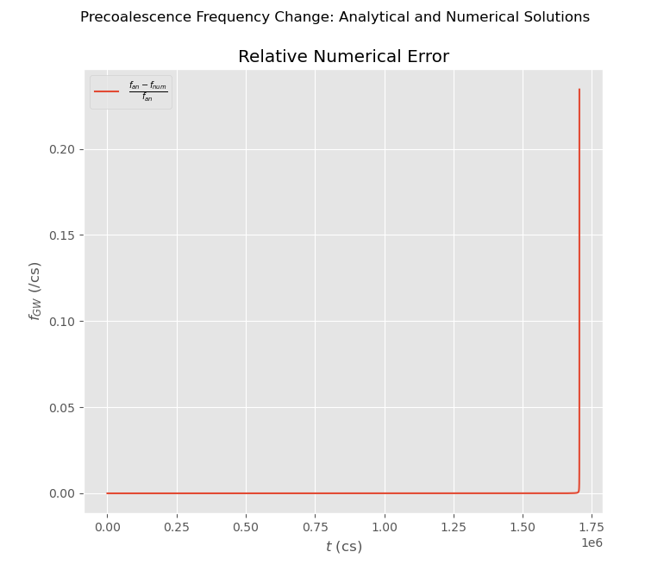

Slide 30
Results

Slide 31
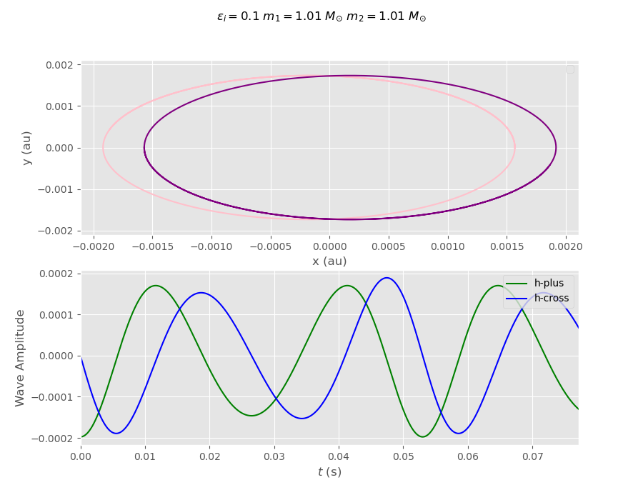
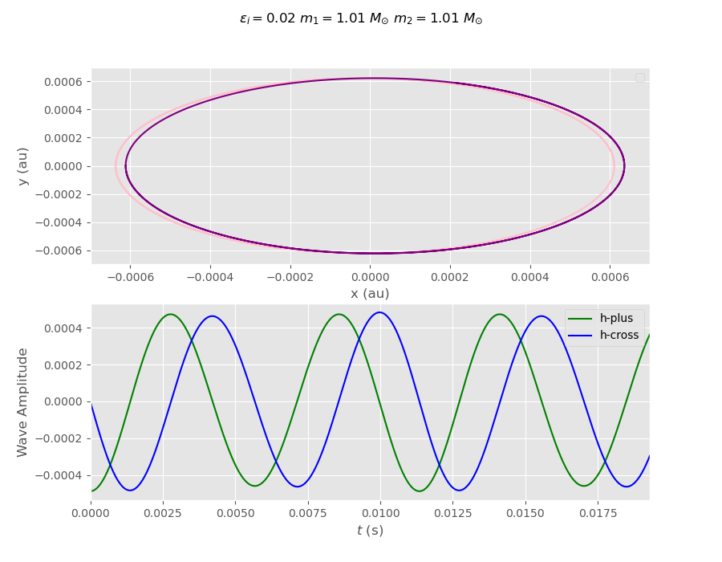

Slide 32
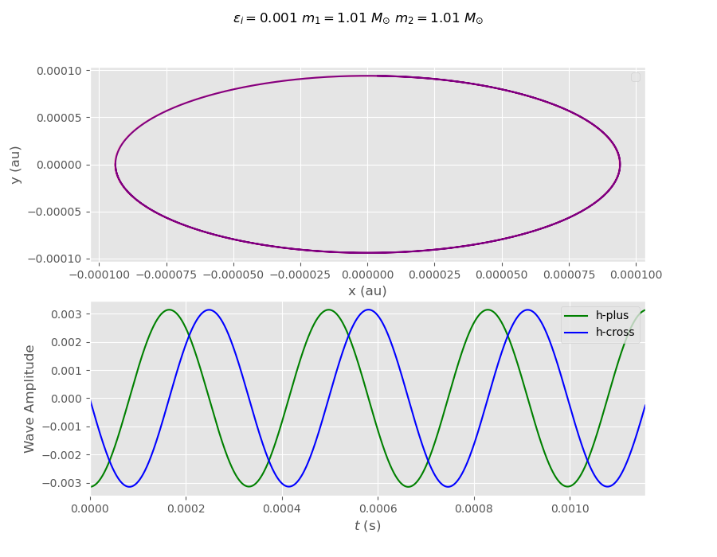
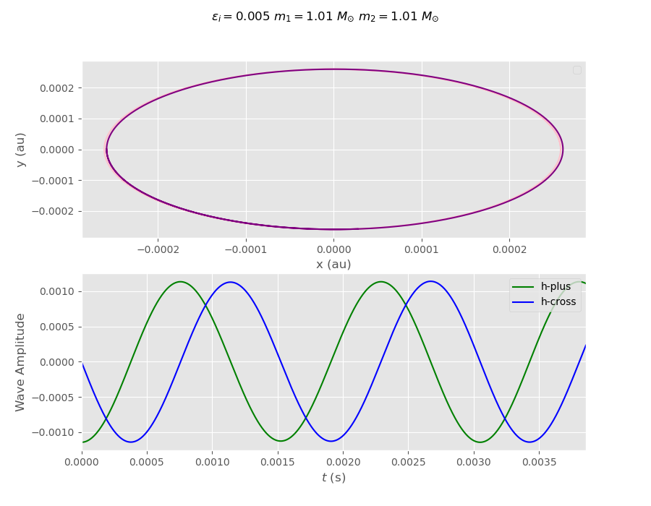

Slide 33
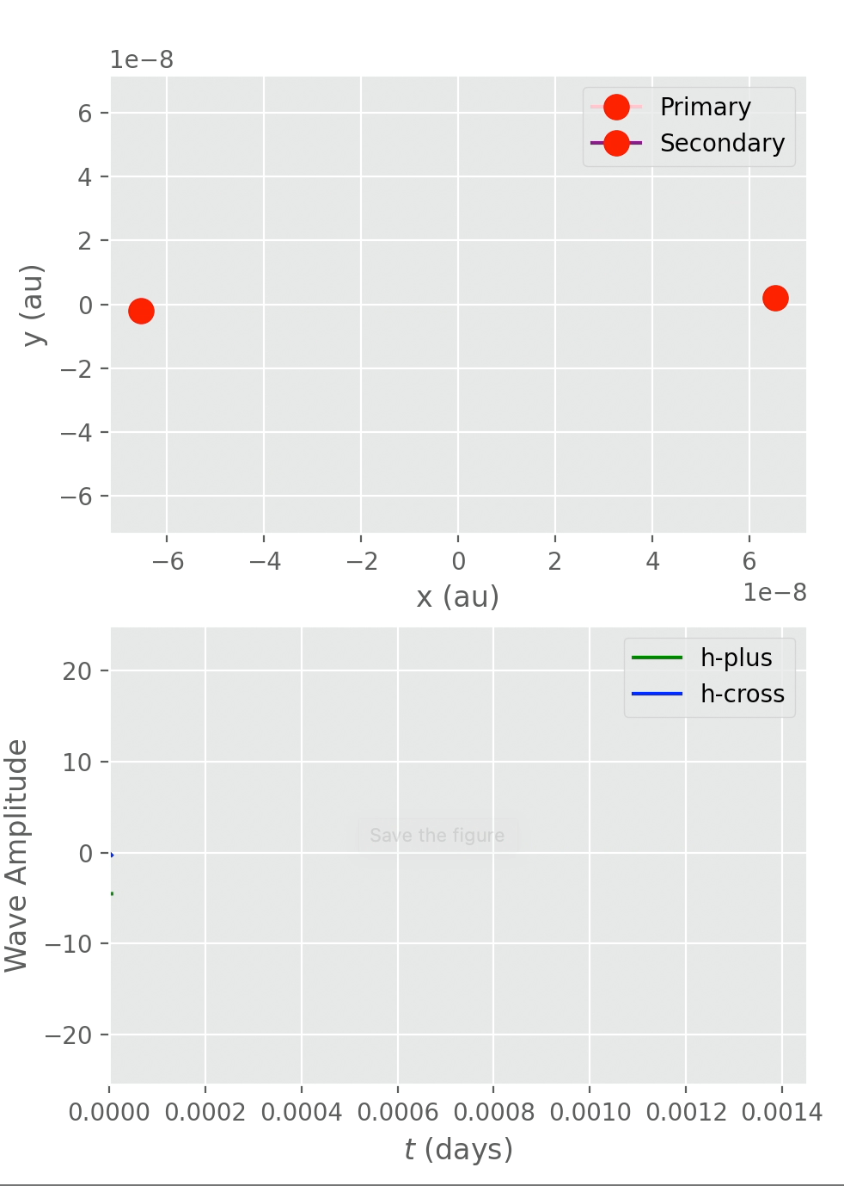
Coalescence

Slide 34
Works Cited: Background
[1] Purdue, Patricia. Introduction to Gravitational Waves, Jan. 2021.
[2] Hartle reading (chapter 2).

Slide 35
Wahlquist
[3] Wahlquist, Hugo. “The Doppler Response to Gravitational Waves from a Binary Star Source”. General Relativity and Gravitation, Vol 19., No. 11, 1987.

Slide 36
Kepler’s Equation
[4] See e.g. Marion and Thornton Chapter 7, Classical Mechanics

Slide 37
Peters Time Evolution
[5] P. C. Peters. “Gravitational Radiation and the Motion of Two Point Masses”. Physical Review, Volume 136 Number 4b, July 1964.
[6] Maggoire, Michele. Gravitational Waves Volume 1: Theory and Expirements. Oxford University Press, 2008.

Slide 38
Numerical Routines
[6] William Press, Saul Teukolsky, William Vettterling, and Brian Flannery. Numerical Recipes: The Art of Scientific Computing. Cambridge University Press, 2007.
[7] Holliwell and Sahakian. Modern Classical Mechanics. Cambridge University Press, 2021.

